Slide 1
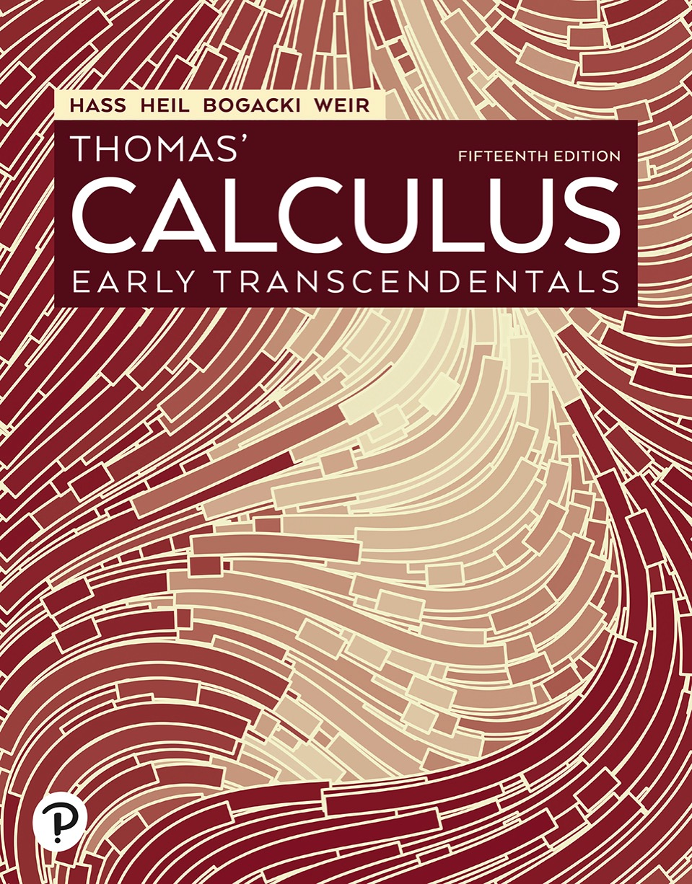

Thomas’ Calculus: Early Transcendentals
Fifteenth Edition
Chapter 13
Vector-Valued Functions and Motion in Space
Copyright © 2023, 2018, 2014 Pearson Education, Inc. All Rights Reserved
Notes:
If this PowerPoint presentation contains mathematical equations, you may need to check that your computer has the following installed:
1) MathType Plugin
2) Math Player (free versions available)
3) NVDA Reader (free versions available)

Slide 2
Section 13.4 Curvature and Normal Vectors of a Curve

Slide 3
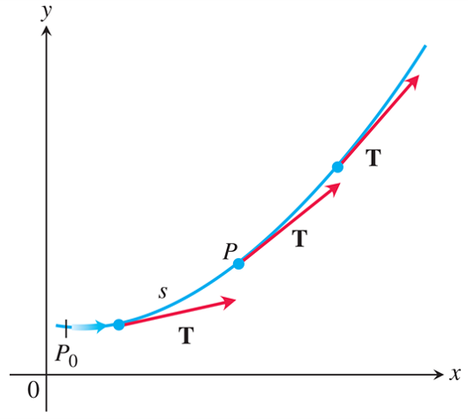
Curvature of a Plane Curve (1 of 12)
As P moves along the curve in the direction of increasing arc length, the unit tangent vector turns. The value of
at P is called the curvature of the curve at P.

Slide 4
Curvature of a Plane Curve (2 of 12)
Definition: If T is the unit vector of a smooth curve, the curvature function of the curve is

Slide 5
Curvature of a Plane Curve (3 of 12)
Formula for Calculating Curvature
If
is a smooth curve, then the curvature is
the scalar function
where
is the unit tangent vector.

Slide 6
Curvature of a Plane Curve (4 of 12)
Example: Here we find the curvature of a circle. We begin with the parametrization
of a circle of radius a. Then,

Slide 7
Curvature of a Plane Curve (5 of 12)
Example (continued):
From this we find

Slide 8
Curvature of a Plane Curve (6 of 12)
Example (concluded):
Hence, for any value of the parameter t, the curvature of the circle is

Slide 9
Curvature of a Plane Curve (7 of 12)
Definition: At a point where
the principal
unit normal vector for a smooth curve in the plane is

Slide 10
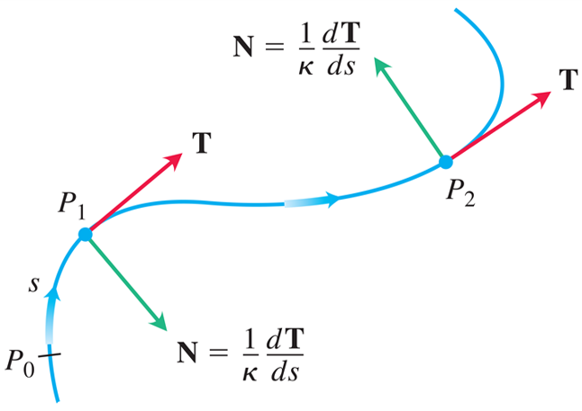
Curvature of a Plane Curve (8 of 12)
The vector
normal to the curve, always points in the
direction in which T is turning. The unit normal vector
N is the direction of
Notes:
The sinusoidal curve passes through P sub zero, P sub one, and P sub two. An arrow moving rightward along the curve is labeled, s. A normal vector extends from P sub one and is labeled, N = start fraction 1 over kappa end fraction derivative of T with respect to s. Vector T moves tangentially from P sub one. The normal vector from P sub two is labeled, N = start fraction 1 over kappa end fraction derivative of t with respect to s. Vector T moves tangentially from P sub two.

Slide 11
Curvature of a Plane Curve (9 of 12)
Formula for Calculating N
If
is a smooth curve, then the principal
unit normal is
Where
is the unit tangent vector.

Slide 12
Curvature of a Plane Curve (10 of 12)
Example: Find T and N for the circular motion
Solution: We first find T:

Slide 13
Curvature of a Plane Curve (11 of 12)
Solution (continued):
From this we find
and

Slide 14
Curvature of a Plane Curve (12 of 12)
Solution (concluded):
Notice that
verifying that N is orthogonal to T.
Notice too, that for the circular motion here, N points
from
toward the circle’s center at the origin.

Slide 15
Circle of Curvature for Plane Curves (1 of 7)
The circle of curvature or osculating circle at a
point P on a plane curve where
is the circle
in the plane of the curve that
1. is tangent to the curve at P (has the same tangent line the curve has)
2. has the same curvature the curve has at P
3. has center that lies toward the concave or inner side of the curve.

Slide 16
Circle of Curvature for Plane Curves (2 of 7)
The radius of curvature of the curve at P is the radius of the circle of curvature, which is

Slide 17
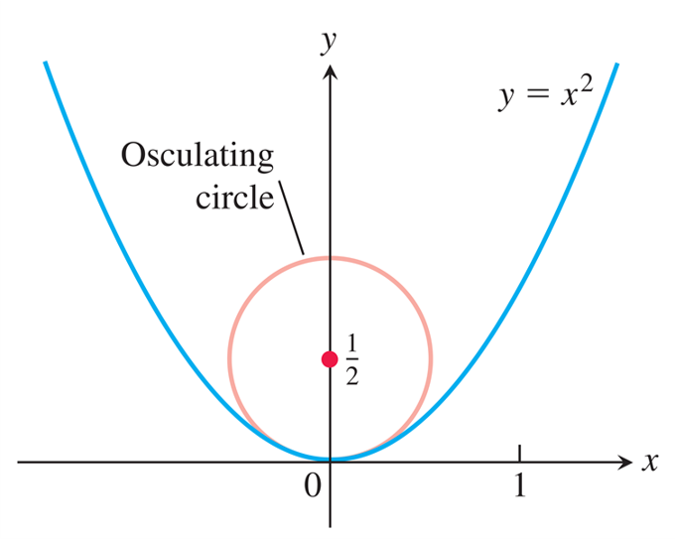
Circle of Curvature for Plane Curves (3 of 7)
The osculating circle for the parabola
at the origin.

Slide 18
Circle of Curvature for Plane Curves (4 of 7)
Example: Find and graph the osculating circle of
the parabola
at the origin.
Solution: We parametrize the parabola using the parameter t = x
First we find the curvature of the parabola at the origin,

Slide 19
Circle of Curvature for Plane Curves (5 of 7)
Solution (continued):
so that
From this we find

Slide 20
Circle of Curvature for Plane Curves (6 of 7)
Solution (continued):
At the origin, t = 0, so the curvature is

Slide 21
Circle of Curvature for Plane Curves (7 of 7)
Solution (concluded):
Therefore, the radius of curvature is
At the origin we have t = 0 and T = i, so N = j. Thus
the center of the circle is
The equation of the
osculating circle is

Slide 22
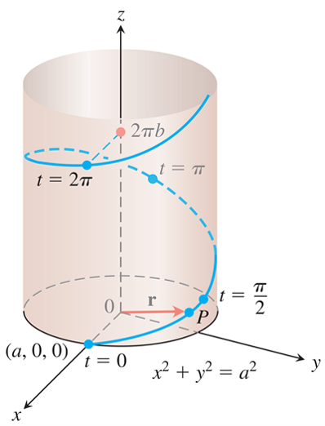
Curvature and Normal Vectors for Space Curves (1 of 6)
The helix
drawn
with a and b positive and

Slide 23
Curvature and Normal Vectors for Space Curves (2 of 6)
Example: Find the curvature for the helix
Solution: We calculate T from the velocity vector v:

Slide 24
Curvature and Normal Vectors for Space Curves (3 of 6)
Solution (continued):
Then,

Slide 25
Curvature and Normal Vectors for Space Curves (4 of 6)
Solution (concluded):
From this equation, we see that increasing b for a fixed a decreases the curvature. Decreasing a for a fixed b eventually decreases the curvature as well.
If b = 0, the helix reduces to a circle of radius a and
its curvature reduces to
as it should. If a = 0, the
helix becomes the z-axis, and its curvature reduces to 0, again as it should.

Slide 26
Curvature and Normal Vectors for Space Curves (5 of 6)
Example: Find N for the helix in the previous Example and describe how the vector is pointing.
Solution: We have

Slide 27
Curvature and Normal Vectors for Space Curves (6 of 6)
Solution (concluded):
Thus, N is parallel to the x y-plane and always points toward the z-axis.

Slide 28
Section 13.5 Tangential and Normal Components of Acceleration

Slide 29
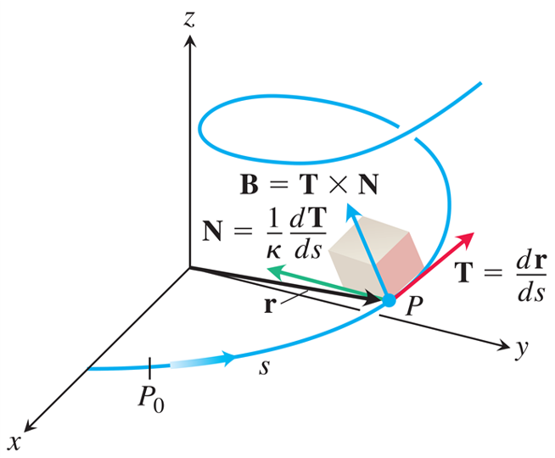
The T N B Frame
The T N B frame of mutually orthogonal unit vectors traveling along a curve in space.
Notes:
The spiral curve starts from the x axis and moves in counterclockwise direction, in an x y z dimensional plane. The curve passes through P sub 0 and P. The distance between point P and P sub 0 is s. Three vectors start from point P. The first vector moves along the negative x axis, the second moves along the negative y axis, and the third moves along the z axis. The vector that moves along the x axis is labeled, T = derivative of r with respect to s. The vector that moves along the y axis is labeled, N = start fraction 1 over kappa end fraction derivative of T with respect to s. The vector that moves along the z axis is labeled, B = T times N.

Slide 30
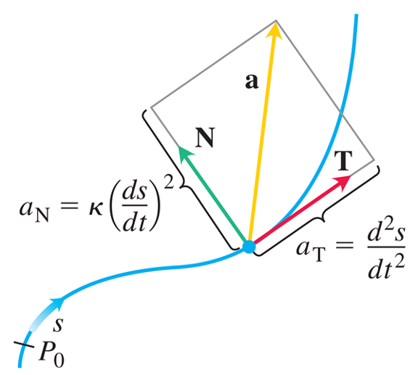
Tangential and Normal Components of Acceleration (1 of 8)
The tangential and normal components of acceleration. The acceleration a always lies in the plane of T and N and is orthogonal to B.
Notes:
A rectangle with length, a sub N = k derivative of s with respect to t squared, and width a sub T = second derivative of s with respect to t. From the bottom left corner, a vector T passes through the width of the rectangle, and a vector N passes through the length of the rectangle. From the same point, vector a runs diagonally to the upper right corner of the rectangle. The path of motion of the particle from P sub 0 passes through the bottom left corner of the rectangle. The path is a sinusoidal curve.

Slide 31
Tangential and Normal Components of Acceleration (2 of 8)
Definition: If the acceleration vector is written as
then
are the tangential and normal scalar components of acceleration.

Slide 32
Tangential and Normal Components of Acceleration (3 of 8)
To calculate
we usually use the formula
which comes from solving the equation
With this formula,
we can find
without having to calculate
first.

Slide 33
Tangential and Normal Components of Acceleration (4 of 8)
Formula for Calculating the Normal Component of Acceleration

Slide 34
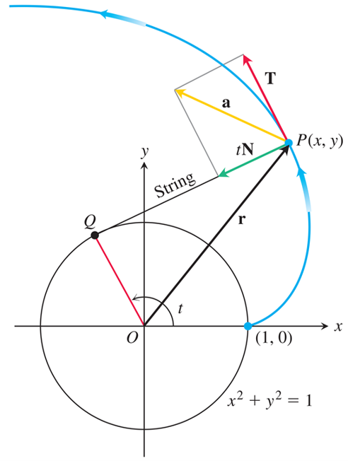
Tangential and Normal Components of Acceleration (5 of 8)
The tangential and normal components of the acceleration of the motion
If a string wound
around a fixed circle is unwound while held taut in the plane of the circle, its end P traces an involute of the circle.
Notes:
The circle has its center at the origin and has a radius of one unit. The curve starts from (1, 0) on the circle and moves to the second quadrant. A vector r from the origin meets the curve at point P (x, y). A line labeled, string, starts from P (x, y) and ends at point Q on the circle in the second quadrant. A line extends from the origin to point Q and makes an angle theta with the positive x axis. Having the string as the base, three vectors, lower t N, a, and upper T, are drawn from point P (x, y). Upper T acts a tangential vector, lower t N vector lies along P Q, and vector a, acts diagonally between vectors upper T and lower t N.

Slide 35
Tangential and Normal Components of Acceleration (6 of 8)
Example: Without finding T and N, write the acceleration of the motion
in the form
Solution: We use the first of Equations to find

Slide 36
Tangential and Normal Components of Acceleration (7 of 8)
Solution (continued):
Knowing
we use the next Equation to find

Slide 37
Tangential and Normal Components of Acceleration (8 of 8)
Solution (concluded):
We then find a:

Slide 38
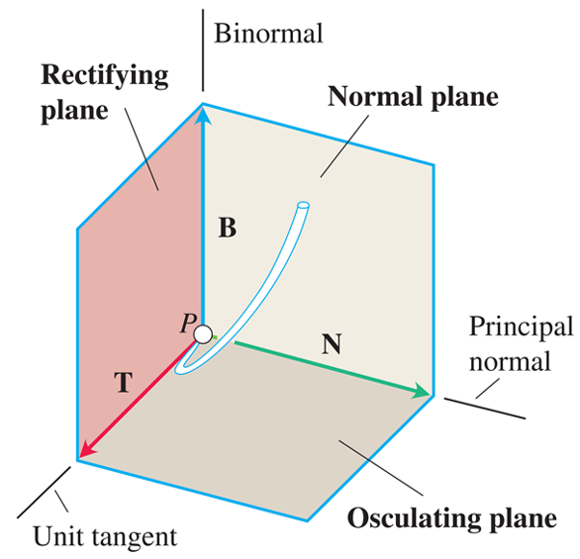
Torsion (1 of 3)
The names of the three planes determined by T, N, and B.
Notes:
Three vectors emerge from point P. The vector T runs along the x axis, the vector N runs along the y axis, and the vector B runs along the z axis. The base of the cube is labeled, osculating plane. The plane between y z axes is labeled, normal plane, and the plane between the x y axes is labeled, rectifying plane. Vector T is labeled, unit tangent. Vector N is labeled, principal normal. Vector B is labeled, binormal.

Slide 39
Torsion (2 of 3)
Definition: Let
The torsion
function of a smooth curve is

Slide 40
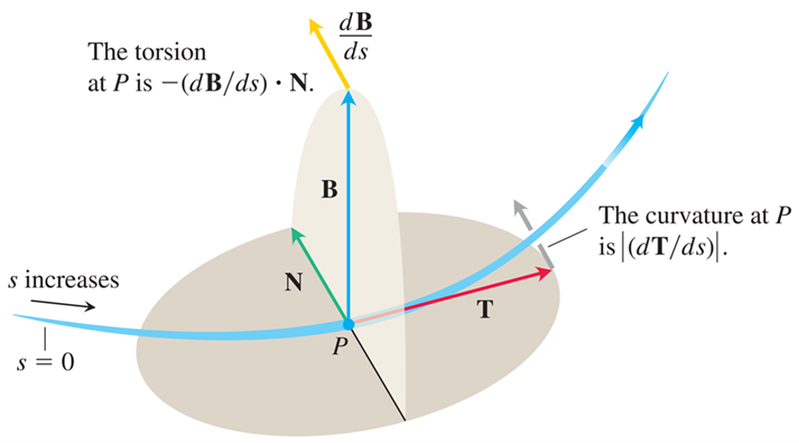
Torsion (3 of 3)
Every moving body travels with a T N B frame that characterizes the geometry of its path of motion.
Notes:
Initially s = 0 and as the body moves along the curve s increases. P is a point on the curved path of the object. A horizontal plane and a vertical plane are constructed from the point P. A horizontal arrow from P along the horizontal plane that extends behind the vertical plane, represents T. An arrow from the end of T toward the curve path is the curvature at a point P, which is the absolute value of start fraction d T over d s end fraction. A vertical arrow from P extends along the vertical plane and represents B. An arrow deviating from the end of B represents start fraction d B over d s end fraction. N is an arrow from P along the horizontal plane that is perpendicular to B and parallel to start fraction d B over d s end fraction. The torsion at P is negative start fraction d B over d s end fraction dot N.

Slide 41
Formulas for Computing Curvature and Torsion (1 of 8)
Vector Formula for Curvature

Slide 42
Formulas for Computing Curvature and Torsion (2 of 8)
Formula for Torsion

Slide 43
Formulas for Computing Curvature and Torsion (3 of 8)
Example: Find the curvature
and torsion
for the helix
Solution: We calculate the curvature:

Slide 44
Formulas for Computing Curvature and Torsion (4 of 8)
Solution (continued):

Slide 45
Formulas for Computing Curvature and Torsion (5 of 8)
Solution (continued):
To evaluate the torsion, we find the entries in the determinant by differentiating r with respect to t. We already have v and a, and

Slide 46
Formulas for Computing Curvature and Torsion (6 of 8)
Solution (concluded):
Hence,

Slide 47
Formulas for Computing Curvature and Torsion (7 of 8)
Computation Formulas for Curves in Space
Unit tangent vector:
Principal unit normal vector:
Binormal vector:
Curvature:

Slide 48
Formulas for Computing Curvature and Torsion (8 of 8)
Torsion:
Tangential and normal scalar components of acceleration:

Slide 49

Copyright
This work is protected by United States copyright laws and is provided solely for the use of instructors in teaching their courses and assessing student learning. Dissemination or sale of any part of this work (including on the World Wide Web) will destroy the integrity of the work and is not permitted. The work and materials from it should never be made available to students except by instructors using the accompanying text in their classes. All recipients of this work are expected to abide by these restrictions and to honor the intended pedagogical purposes and the needs of other instructors who rely on these materials.

